Slide 1
OBIGBO NODE AGG FACILITIES F&G HMI UPGRADE PROJECT
Charter Template
Background: Define the problem that is being addressed. Why do we need the project
The Obigbo node has fire and gas protection system for Agbada AGG, Imo River AGG, Obigbo AGG and Obigbo sales gas manifold. These systems shut the plant down safely in the event of suspected or confirmed plant fire and gas release. The operator interfaces and manipulates the fire and gas protection system through the HMI. A crashed and faulty HMI means operating the plant without due control over safety issues.
Business Case: This project will not bring in additional production , but it will enable a safe production of circa 45mmScf per day of domestic gas. More importantly, it will greatly contribute to personnel safety and avert incessant shut down due to fault.
Potential Benefits & Measurement:
This project will enable a safe production of circa 45MMSCF/d resulting to USD 135,000 per.
It will largely contribute to personnel safety within the operating environment.
Project Scope/Actions :
Assess challenges with the F&G system along side the OEM rep.
Identify scope of upgrade of each of the facilities.
Identify spares required for upgrade for each of the facilities.
Raise PO for vendor.
Track material until reception.
Develop plan to implement upgrade.
Implement upgrade on various identified facilities.
Commission systems and hand back to asset.
Cost of project is USD 160K.
Critical Success Factors:
Availability of budget.
Assess to facility.
High-level Timeline:
L0-L1: Slide 2 below will guide on this.
L2:
L3:
L4:
L5:
Initiative End
Project Sponsor:Ezugworie C.S/Tijani T
Implementation Lead: Iyoloma C
Project Team: Omogiate Solomon, Oni Olabanji, Otah Charles, Wokoma Esther, Osuji bell Soba,Memuletiwon Daniel.

Slide 2
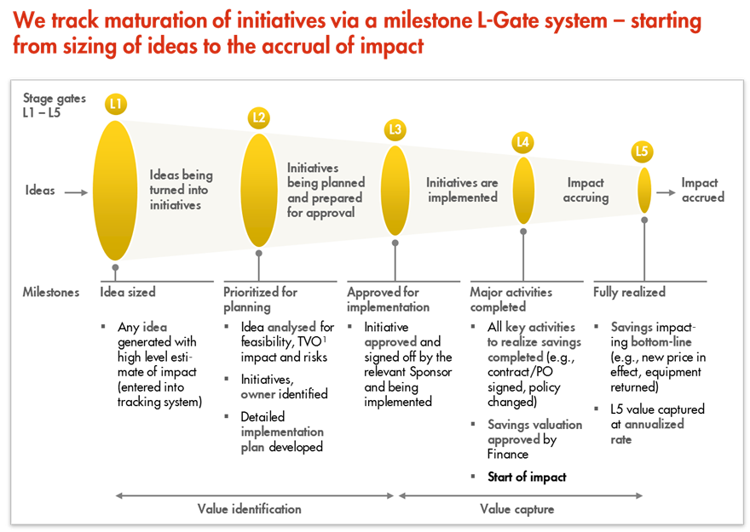
L1 – L5 Gates

